Slide 1



School Staff Workshop

Slide 2

INTRODUCTION AND PRESENTATION
Introduction and presentation
1

Slide 3
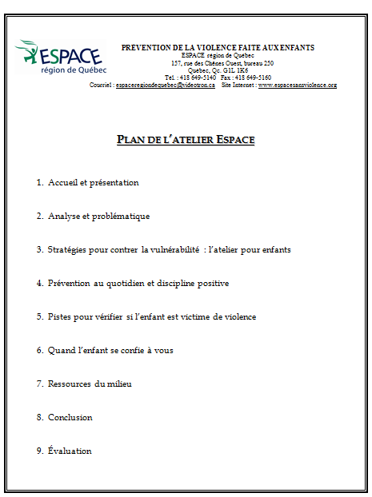


INTRODUCTION AND PRESENTATION
Presentation of the documents
Folder
4

Slide 4

INTRODUCTION AND PRESENTATION
Since
1989
Preventing all forms of violence against children.
School staff
3 components
Parents and caretakers
Children
1

Slide 5
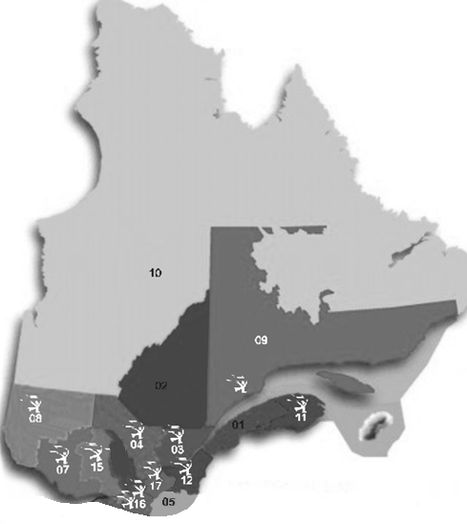





INTRODUCTION AND PRESENTATION
10 groups in the province
www.espacesansviolence.org
3

Slide 6
INTRODUCTION AND PRESENTATION
    Elementary schools: 100%
    All the schools on our territory, attached to both the francophone and anglophone schoolboards, have already received the ESPACE program at least once. We visited every daycare center (CPE) as well.
    Repeat every 3-4 years.
    Objective: all children take part in the workshop twice during their elementary schooling
2

Slide 7
ANALYSIS
Analysis of the problematic
5

Slide 8
ANALYSIS
1. A Dynamic of Abuse of Power

Slide 9
ANALYSIS
In real life, it may be hard to recognize and identify violence.
It may be confused with anger or aggressivity.
8

Slide 10
Anger – Aggressivity – Violence
Anger:
Intense emotion
Can be triggered by a feeling of injustice or an unfulfilled need
Force for change
Aggressivity:
Pulsion, irrational reaction
Losing control
Often unproductive
Violence:
Done by a person in a position of power/authority
Taking control
Used rationally in order to obtain something

Slide 11
ANALYSIS
2. Violence against children
7

Slide 12
ANALYSIS
Violence against children
is the expression of an abuse of power by an adult over a child or by a child over a more vulnerable one.

Slide 13
ANALYSIS
According to you, what makes children more vulnerable to violence in our society?
Lack of information
Dependence towards adults
Social isolation
9

Slide 14
The ESPACE program has been created in order to reduce children’s vulnerability and empower them to react to situations of violence.
ESPACE focuses on assertiveness, peer support and inner strength to prevent violence.
13

Slide 15
CHILDREN’S WORKSHOPS
DESCRIPTION OF THE IN-CLASS WORKSHOPS FOR CHILDREN
11

Slide 16
CHILDREN’S WORKSHOPS
General information…
ESPACE meets all children and the adults around them.
The workshops are adapted to the kids’ age
The key concepts are always the same.
Presented by 3 ESPACE facilitators.
Role-play scenarios: negative and positive versions.
Victims are both boys and girls.
14

Slide 17
CHILDREN’S WORKSHOP
Themes covered in the role-playing scenarios:
Bullying (rejection)
Verbal and psychological violence
Physical violence
Sexual violence
Bribery/blackmail, manipulation, threats, secrets
Domestic violence
Security on the Internet
15

Slide 18

CHILDREN’S WORKSHOP
The strategies
Important that the children come up with them. They are always the same:
  SAY NO
16

Slide 19

CHILDREN’S WORKSHOP
  ASK YOUR FRIENDS FOR HELP
17

Slide 20
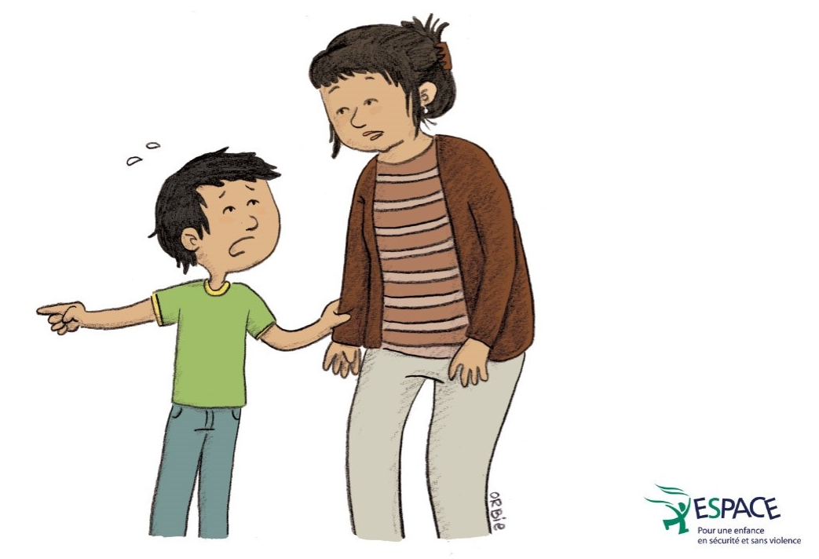
CHILDREN’S WORKSHOP
  TALK TO AN ADULT YOU CAN TRUST
18

Slide 21

CHILDREN’S WORKSHOP
  USE SELF-DEFENCE AND YELL
  (in case of emergency)

Slide 22
CHILDREN’S WORKSHOP
Identify 3 trusted adults
Distribution of certificates
Transition activity and individual meetings:
  On a voluntary basis, with the facilitator they choose;
  Allow children to share comments, review content, and get support or resources if needed.

Slide 23
CHILDREN’S WORKSHOP
WORKSHOP FOR PRESCHOOLERS
Duration: on 3 consecutive days, for 30-40 minutes each time
Same key concepts, but adapted to their age and comprehension

Slide 24
CHILDREN’S WORKSHOP
Activity books to complement the ESPACE program
Activity books intended for children:

Slide 25

CHILDREN’S WORKSHOP
Activity book intended for the educational staff:
Preparatory activities
- Kindergarten : p.7
- 1st cycle : p.24
2nd cycle : p.34 to 36 - 3rd cycle : p.48 to 50
More ideas and tools available online at www.espacesansviolence.org

Slide 26
HOW TO FIND OUT IF A CHILD IS VICTIM OF VIOLENCE
22

Slide 27
HOW TO FIND OUT…
Not all children react the same way to violence
It depends on:
their age;
their personality;
the type of violence and severity;
the frequency and how long it’s been going on;
their relationship with the aggressor;
the presence or absence of significant people in their life.
24

Slide 28
HOW TO FIND OUT…
Exercise
« Changes of behaviour»
22

Slide 29
HOW TO FIND OUT…
Stress in children is usually caused by…
New situations: moving, entering school, the birth of a brother or sister, etc.
Difficult moments: exams, divorce, death in the family, arguments with friends, etc.
But, as we saw, the reason behind the child’s stress may be violence.
23

Slide 30
HOW TO FIND OUT…
Remaining silent or lying for various reasons
Fear of not being believed.
Fear of punishment.
Feeling of guilt.
Desire to protect the aggressor.
25

Slide 31
HOW TO FIND OUT…
How to verify my suspicions?
By taking the first steps, and speaking openly about your observations and concerns. Make sure to respect the child’s rhythm and needs.
Ex: Listen, I feel like you are not going too well, and I worry about you. Would you like to talk about it? Maybe we can find a solution together.

Slide 32
When a child confides in you

Slide 33
WHEN A CHILD CONFIDES IN YOU
Brainstorm
« Attitudes that could ease the confidence »
Folder
26

Slide 34
WHEN A CHILD CONFIDES IN YOU
Attitudes that could ease the confidence
1. Find a quiet and discrete environment;
2. Believe what the children are saying (it may be the first time they talk about it) ;
3. Stay calm;
4. Emphasize that what happened is not their fault;
5. Do not correct the children’s vocabulary. If they don’t find the words, encourage them to use gestures or images;
6. Be as open-minded as possible (avoid judgement);

Slide 35
WHEN A CHILD CONFIDES IN YOU
7. Validate their emotions (it’s normal to feel afraid, angry, sad….);
8. Tell them they did well to talk about it, that they are brave;
9. Ask open-ended questions (instead of leading or suggestive ones);
10. Evaluate the immediate threats to the children’s safety;
11. Ask them how you can help them (include them in the search for solutions);
Let the children know what you are planning to do;
13. Do not make promises that you cannot keep.

Slide 36
WHEN A CHILD CONFIDES IN YOU
Simulation

Slide 37
If I am aware of a situation of violence, what resources can help me?

Slide 38
Who can help me?
EXISTING RESOURCES
OTHER RESOURCES
SCHOOL SYSTEM/
DAYCARE
811
Secretary
RELATIVES
Direction
DYP
Family
ME
Friends
Educational personnel
Partner
Professional services
Hospitals
Peer support groups
CLSC
CISSS/CIUSSS
Daycare personnel
Community organizations
27

Slide 39
EXISTING RESOURCES
The Youth Protection Act
As professionals, if you believe that a child is a victim of physical or sexual violence, of serious neglect, of abandonment, of psychological ill-treatments, or if he or she has severe behavioural problems (drug abuse, suicide attempt, runaway, criminality, etc.): you are required by law to report it immediately to the Director of Youth Protection.
This Law offers you immunity: no lawsuit can be instituted against you.
The report is confidential: your name will never be disclosed.
The case file will stay opened for 2 years, in the whole province.
If you are unsure wether you should report or not, you can contact the DYP for advice.
28

Slide 40

CONCLUSION
Your involvement in prevention efforts can make a difference for children. You can help them…
be better informed on the question of violence and on possible solutions;
be more autonomous and confident in their own capacities;
be less isolated from helpful people and resources.
30

Slide 41


Thank you!
(Please don’t forget to fill in the evaluation form.)
This project received financial support from:
31

