Slide 1



Workshop for parents and caregivers

Slide 2

INTRODUCTION AND PRESENTATION
Introduction and presentation
1

Slide 3
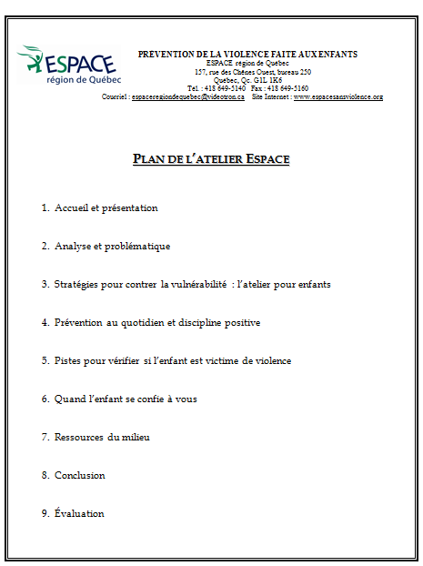


INTRODUCTION AND PRESENTATION
Presentation of the documents
Folder
4

Slide 4

INTRODUCTION AND PRESENTATION
Since
1989
Preventing all froms of violence against children.
School staff
3 components
Parents and caretakers
Children
1

Slide 5
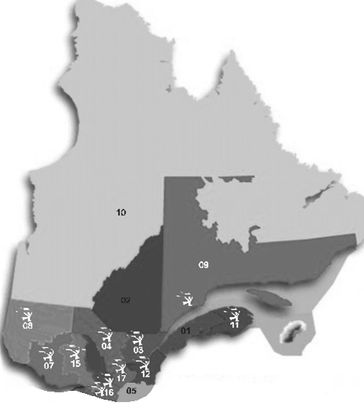





INTRODUCTION AND PRESENTATION
10 groups in the province
www.espacesansviolence.org
3

Slide 6
INTRODUCTION AND PRESENTATION
    Elementary schools: 100%
    All the schools on our territory, attached to both the francophone and anglophone schoolboards, have already received the ESPACE program at least once. We visited every daycare center (CPE) as well.
    Repeat every 3-4 years.
    Objective: all children take part in the workshop twice during their elementary schooling
2

Slide 7
ANALYSIS
Analysis of the problematic
5

Slide 8
ANALYSIS
1. A Dynamic of Abuse of Power

Slide 9
ANALYSIS
Brainstorm
« Abuse of power »
5

Slide 10
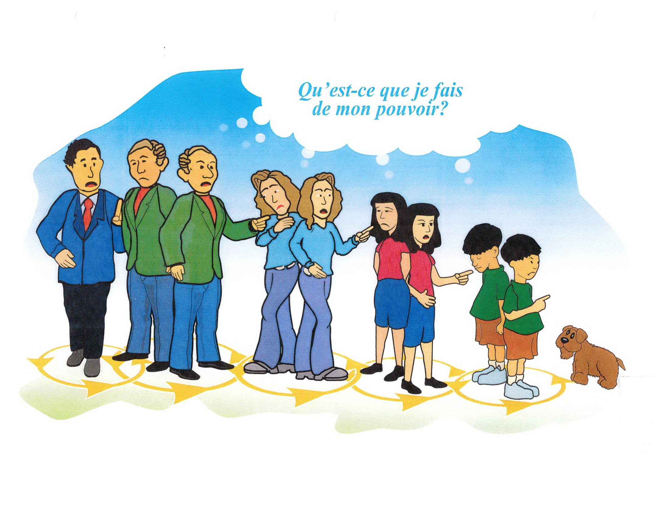
ANALYSIS
How am I using my power?
We may be in a position to both receive and produce power abuses.
A single aggression can affect various people (chain reaction).
6

Slide 11
ANALYSIS
In real life, it may be hard to recognize and identify violence.
It may be confused with anger or aggressivity.
8

Slide 12
Anger – Aggressivity – Violence
Anger:
Intense emotion
Can be triggered by a feeling of injustice or an unfulfilled need
Force for change
Aggressivity:
Pulsion, irrational reaction
Losing control
Often unproductive
Violence:
Done by a person in a position of power/authority
Taking control
Used rationally in order to obtain something

Slide 13
ANALYSIS
2. Violence against children
7

Slide 14
ANALYSIS
Violence against children
is the expression of an abuse of power by an adult over a child or by a child over a more vulnerable one.

Slide 15
ANALYSIS
Forms of violence
VERBAL VIOLENCE
BULLYING
NEGLECT
PHYSICAL VIOLENCE
PSYCHOLOGICAL VIOLENCE
SEXUAL VIOLENCE

Slide 16

Questionnaire

Slide 17
1. Assaults on children are mainly the result of:
(B) An abuse of power
A great majority of aggressors function normally in all aspects of their life.
Violence is used rationally, in a controlled manner.
For example, 97% of the people convicted of sexual assault on children have a ‘normal’ psychological profile.
Source: Badgley report, 1984

Slide 18
2. How many children will be victims of sexual assault before the age of 18?
(A) 1/3 girls and 1/6 boys 1
Not only rape…
Around 79% of sexual assaults are not isolated incidents. 2
Up to 90% of the assaults are not reported to the police. Silence is the attacker’s best weapon but, for the victim, bearing that secret can be destructive.3
Source: 1- Orientations gouvernementales en matière d’agression sexuelle, Gouvernement du Québec, 2011. 2- Badgley report, 1984. 3- Les agressions sexuelles au Québec, Ministère de la Sécurité publique, 2004.

Slide 19
3. In Canada, an episode of bullying occurs every _______minutes in a schoolyard.
(B) 7 minutes
Characteristics:
aggressive or ill-intended behavior,
in a majority of cases, it is repeated and lasts in time,
the victim experiences distress due to power imbalance.
85 % of the incidents are witnessed by other children. Teachers, on the other hand, are only aware of 4% of the cases.
When peers (other children) intervene, bullying stops in less than 10 seconds, 57% of the time.
Source: Bâtir des communautés plus sûres, Ministère de la justice du Gouvernement du Canada, 2003.

Slide 20

4.In Canada, how many students per class are exposed to acts of conjugal violence against their mother?
C) 2 to 6 children (or 11% to 23%)
There are 2 ways the child may be exposed:
Directly, by being physically present and witnessing the violence, or being in another room and hearing shouts, insults, blows, etc.
Indirectly, if the child was not in the house during the event, but could later notice its visible consequences: broken objects, wounds, etc.
Source: Suberman et Jaffe, 1999.

Slide 21
5. True or false? By respecting these following rules, children will be protected against any form of assault:
Don’t talk to strangers
Don’t take candy from a stranger
Don’t get into a car with a stranger
Don’t wear provocative clothing

Slide 22
FALSE
Most aggressions are committed by adults the child knows and even likes. (Ex. sexual assaults: 15% by strangers, 85% by known people)
These « Do-not » strategies :
Create fear, helplessness and vulnerability;
Project responsibility and blame on the victim for not respecting the rules;
Fail to empower children to react if violence occurs despite these precautions.
This is why we like to focus on other, more positive strategies in our efforts to prevent violence.
Source: Orientations gouvernementales en matière d’agression sexuelle, Gouvernement du Québec, 2011.

Slide 23
ANALYSIS
According to you, what makes children more vulnerable to violence in our society?
Lack of information
Dependence towards adults
Social isolation
9

Slide 24
The ESPACE program has been created in order to reduce children’s vulnerability and empower them to react to situations of violence.
ESPACE focuses on assertiveness, peer support and inner strength to prevent violence.
13

Slide 25
CHILDREN’S WORKSHOPS
Description of the in-class workshops for children
11

Slide 26
CHILDREN’S WORKSHOPS
General information…
ESPACE meets all children and the adults around them.
The workshops are adapted to the kids’ age
The key concepts are always the same.
Presented by 3 ESPACE facilitators.
Role-play scenarios: negative and positive versions.
Victims are both boys and girls.
14

Slide 27
CHILDREN’S WORKSHOP
Themes covered in the role-playing scenarios:
Bullying (rejection)
Verbal and psychological violence
Physical violence
Sexual violence
Bribery/blackmail, manipulation, threats, secrets
Domestic violence
Security on the Internet
15

Slide 28


All children have the right to feel

Slide 29
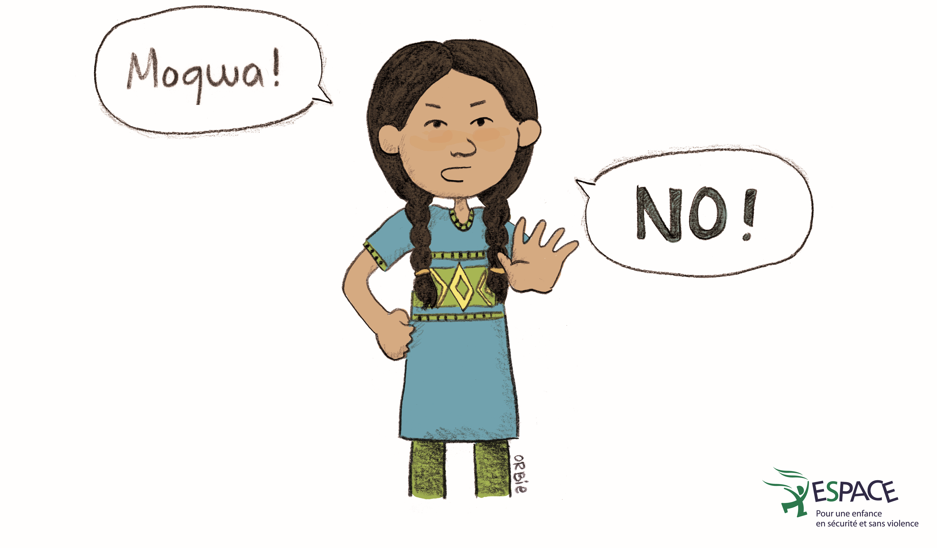
CHILDREN’S WORKSHOP
The strategies we can use when someone tries to take away our rights
Important that the children come up with them. They are always the same:
  SAY NO
16

Slide 30
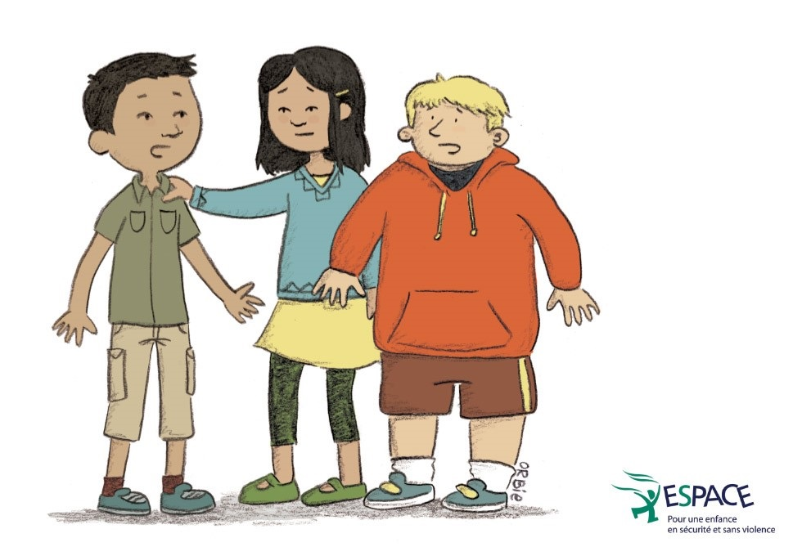
CHILDREN’S WORKSHOP
  ASK YOUR FRIENDS FOR HELP
17

Slide 31
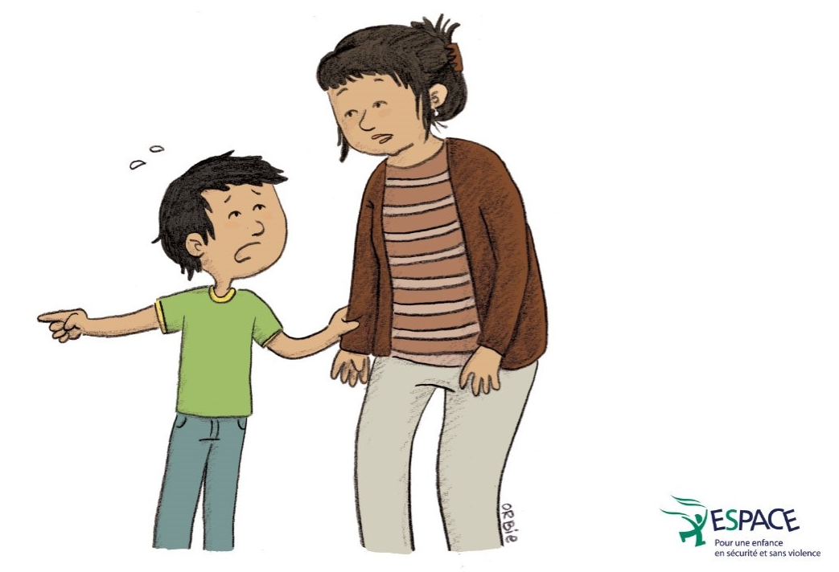
CHILDREN’S WORKSHOP
  TALK TO AN ADULT YOU CAN TRUST
18

Slide 32
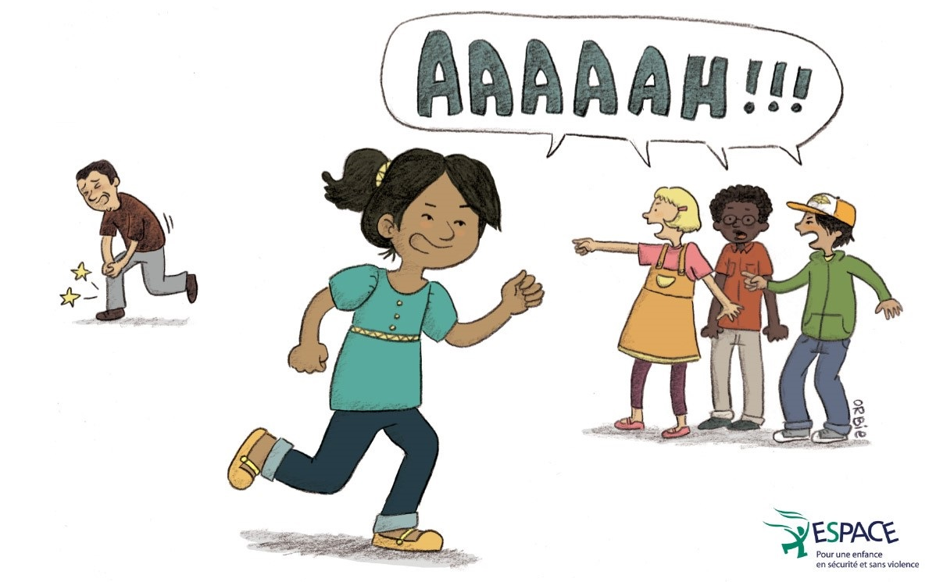
CHILDREN’S WORKSHOP
  USE SELF-DEFENCE AND YELL
  (in case of emergency)

Slide 33
CHILDREN’S WORKSHOP
Identify 3 trusted adults
Distribution of certificates
Transition activity and individual meetings:
  On a voluntary basis, with the facilitator they choose;
  Allow children to share comments, review content, and get support or resources if needed.

Slide 34
CHILDREN’S WORKSHOP
WORKSHOP FOR PRESCHOOLERS
Duration: on 3 consecutive days, for 30-40 minutes each time
Same key concepts, but adapted to their age and comprehension

Slide 35
CHILDREN’S WORKSHOP
Activity books to complement the ESPACE program
Activity books handed out to children:

Slide 36
Everyday prevention and positive discipline

Slide 37

Everyday prevention and positive discipline
Everyday prevention = speaking openly about violence and protection strategies.
How and when?
Chapter 2 - page 8
19

Slide 38
Everyday prevention and positive discipline
But everyday prevention is also…
Building self-esteem
Fostering autonomy and a sense of responsibility
Modelling respect and self-respect
Spending quality time together
Teaching empathy
Transmitting values…
A way to do that is through… discipline!
19

Slide 39

Everyday prevention and positive discipline
If a child spills his/her fruit juice...
Various possible reactions:
some represent a more ‘traditionnal’ discipline type; others, a more ‘positive’ discipline type.
7

Slide 40
Everyday prevention and positive discipline
What is positive discipline?
A system of rules and consequences that, while being structuring for children, also considers their emotional needs and promotes autonomy and responsibility.
7

Slide 41
Children are more inclined to follow rules that are…
Clear and reassuring
Concrete and realistic
5C
Constant and predictable
Consistent
Consequent
20

Slide 42

Highlight good behavior
Ignore or react?
Danger?
Impact?
20

Slide 43

Describe the behavior
(instead of the child)
Name what was done wrong
Say what is expected instead
Express how you felt
20

Slide 44

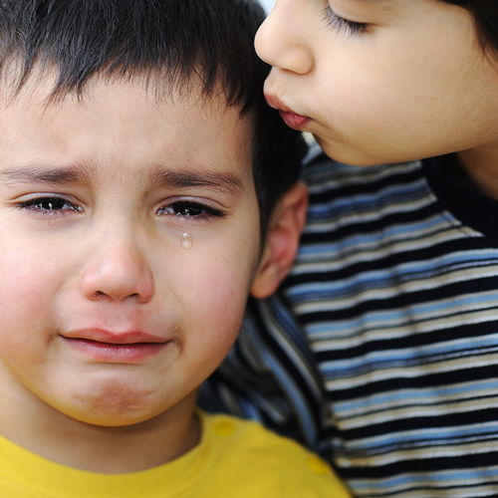
Let consequences be repairing
Message: mistakes are normal and can be forgiven
Logical and consistent with the misconduct
Requires a real effort
20

Slide 45
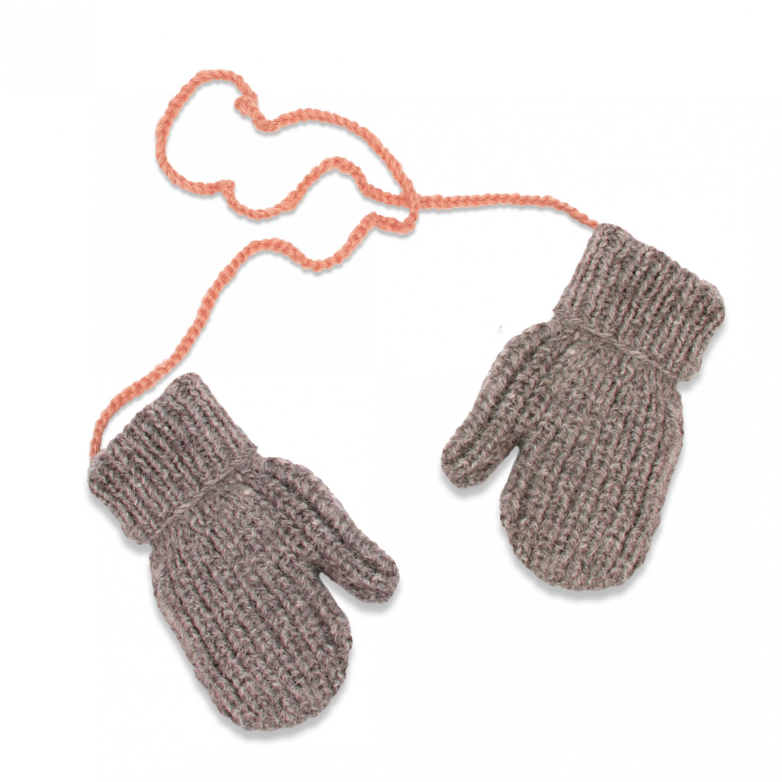
Offer choices
and
Let children make their own observations
20

Slide 46
If the situation is beyond me…
Take a step back
3 ‘takes’
Take a deep breath
Take action
20

Slide 47
HOW TO FIND OUT IF A CHILD IS VICTIM OF VIOLENCE
22

Slide 48
HOW TO FIND OUT…
Not all children react the same way to violence
It depends on:
their age;
their personality;
the type of violence and severity;
the frequency and how long it’s been going on;
their relationship with the aggressor;
the presence or absence of significant people in their life.
24

Slide 49
HOW TO FIND OUT…
Exercise
« Changes of behaviour»
22

Slide 50
HOW TO FIND OUT…
Stress in children is usually caused by…
New situations: moving, entering school, the birth of a brother or sister, etc.
Difficult moments: exams, divorce, death in the family, arguments with friends, etc.
But, as we saw, the reason behind the child’s stress may be violence.
23

Slide 51
HOW TO FIND OUT…
Remaining silent or lying for various reasons
Fear of not being believed.
Fear of punishment.
Feeling of guilt.
Desire to protect the aggressor.
25

Slide 52
HOW TO FIND OUT…
How to verify my suspicions?
By taking the first steps, and speaking openly about your observations and concerns. Make sure to respect the child’s rhythm and needs.
Ex: Listen, I feel like you are not going too well, and I worry about you. Would you like to talk about it? Maybe we can find a solution together.

Slide 53
When a child confides in you

Slide 54
WHEN A CHILD CONFIDES IN YOU
Brainstorm
« Attitudes that could ease the confidence »
Folder
26

Slide 55
WHEN A CHILD CONFIDES IN YOU
Attitudes that could ease the confidence
1. Find a quiet and discrete environment;
2. Believe what the children are saying (it may be the first time they talk about it) ;
3. Stay calm;
4. Emphasize that what happened is not their fault;
5. Do not correct the children’s vocabulary. If they don’t find the words, encourage them to use gestures or images;
6. Be as open-minded as possible (avoid judgement);

Slide 56
WHEN A CHILD CONFIDES IN YOU
7. Validate their emotions (it’s normal to feel afraid, angry, sad….);
8. Tell them they did well to talk about it, that they are brave;
9. Ask open-ended questions (instead of leading or suggestive ones);
10. Evaluate the immediate threats to the children’s safety;
11. Ask them how you can help them (include them in the search for solutions);
Let the children know what you are planning to do;
13. Do not make promises that you cannot keep.

Slide 57
WHEN A CHILD CONFIDES IN YOU
Simulation

Slide 58
If I am aware of a situation of violence, what resources can help me?

Slide 59
Who can help me?
EXISTING RESOURCES
OTHER RESOURCES
SCHOOL SYSTEM/
DAYCARE
811
Secretary
RELATIVES
Direction
DYP
Family
ME
Friends
Educational personnel
Partner
Professional services
Hospitals
Peer support groups
CLSC
CISSS/CIUSSS
Daycare personnel
Community organizations
27

Slide 60
EXISTING RESOURCES
The Youth Protection Act
If you are aware that a child is victim of physical or sexual violence, the law requires you to report it immediately to the Director of Youth Protection.
If you think a child is in a situation of serious neglect, abandonment, psychological ill-treatments, or if he or she has severe behavioural problems (drug abuse, suicide attempt, runaway, criminality, etc.), you are invited to report it to the DYP.
This Law offers you immunity and confidentiality: your name will never be disclosed, and no lawsuit can be instituted against you.
The case file will stay opened for 2 years, in the whole province.
28

Slide 61

CONCLUSION
Your involvement in prevention efforts can make a difference for children. You can help them…
be better informed on the question of violence and on possible solutions;
be more autonomous and confident in their own capacities;
be less isolated from helpful people and resources.
30

Slide 62


Thank you!
(Please don’t forget to fill in the evaluation form.)
This project received financial support from:
31

